Slide 1
State Board Presentation: 2024 Alaska Social Studies Standards
Alaska Department of Education and Early Development
Kelly Manning, Deputy Director for Alaska Department of Education and Early Development
Kimberly Imel, Researcher at American Institutes for Research
October 8-9, 2024

Slide 2
Agenda
Context for the Standards Revision Work
Background on Standards
Overview of Standards Revision Process
Overview of the Standards and Key Instructional Shifts
Q&A

Slide 3
Context for the Standards Revision Work

Slide 4
The Charge
The Department of Education and Early Development (DEED) has committed to updating the Alaska Social Studies Standards, as they have not been reviewed since 1998. DEED recognizes that the development of statewide standards requires a coordinated approach with a variety of opportunities for stakeholder input.
The process will take the range of Alaska stakeholder voices into account, organize, and focus the project through the support of a facilitator experienced with bringing together a broad-based stakeholder group, and ensure each step of the process can be completed plan fully and with enough time for discourse.

Slide 5

Strategic Priorities:
Alaska’s Education Challenge
Five Shared Priorities:
Support all students to read at grade level by the end of third grade.
Increase career, technical, and culturally relevant education to meet student and workforce needs.
Close the achievement gap by ensuring equitable educational rigor and resources.
Prepare, attract, and retain effective education professionals.
Improve the safety and well-being of students through school partnerships with families, communities, and tribes.
education.alaska.gov/akedchallenge
Notes:
Alaska’s Education Challenge Priority #3 asks us to: Close the achievement gap by ensuring equitable educational rigor and resources. A key to meeting this priority is ensuring that we have rigorous standards that are aligned to national standards and best practices in the field of study while also reflecting the local Alaska cultural and geographic contexts.

Slide 6
Mission and Vision of the Standards
Mission | Vision
The mission of Alaska’s social studies standards is to provide Alaska students with the knowledge and skills required to become civically engaged, socially responsible, and culturally aware citizens. | The vision for Alaska’s social studies standards is to use current evidence‐based practices, research, and data to collaboratively promote and encourage an excellent education for all students that celebrates the diversity of peoples, cultures, perspectives, voices, and ideologies in Alaska while empowering students to be meaningfully engaged citizens.

Slide 7
Background on Standards

Slide 8

Key Elements Underlying the Standards
Standards outline what students need to know, understand, and be able to do.
Standards should be developmentally appropriate and relevant to future employment and education needs.
Standards should be written so that all students are capable of achieving them, reflecting the belief that all students are capable of learning and meeting high expectations. Both advanced and struggling students can learn new things in their own ways and at their own rates.
Standards should value both excellence and equity.
Standards should be written to empower teachers to make decisions essential for effective learning, rather than having a teaching style prescribed.

Slide 9
What Is the Purpose of Standards?
Reflect the ideas, skills, and knowledge in each discipline that are important enough for everyone to learn.
Set clear expectations that outline what students should know and be able to do at each grade level and content area.
Provide clear understanding of the concepts and skills that students need to master to help ensure they are career ready.
Set goals for what students should know and be able to do to be college and career ready.

Slide 10
The Relationship of Standards to Classroom Instruction
Standards
Broad goals articulating what students should know, understand, and be able to do over a given time period.
State
Curriculum
An organized plan of instruction: a sequence of instructional units.
Local Districts
Instruction
Learning experiences designed to meet the needs of students.

Slide 11
Pause and Reflect

Slide 12
Overview of Standards Revision Process

Slide 13

Transparent and Collaborative Process
AHWG
EWG
GPWG
Reflective Friends and Focus Group
Working Groups
Notes:
The standards revision process was transparent and collaborative with intentional efforts to consistently include and honor multiple perspectives on what students should know and be able to do. The following were involved in developing, reviewing, and providing feedback on the standards:
GPWG - The function of the GPWG was to develop guiding principles for the standards revision process. This included representatives from organizations such as the Alaska Municipal League, Institute of the North, and Alaska Association of School Boards, along with a superintendent and social studies curriculum coordinator.
AHWG - The function of the AHWG was to develop guidance for the inclusion of state history, Tribal government, and Indigenous histories. This included educators, education leaders, and representatives of Alaska tribes (e.g., Sitka Tribe of Alaska, Goldbelt Heritage Foundation, and Alaska Native Heritage Center).
EWG - The function of the EWG was to refine, revise, and develop appropriate standards to meet Alaska’s current needs that align with current national standards and reflect the cultural perspectives of Alaska. When choosing writers, the selection committee considered statewide representation for public elementary, middle, and high school educators.
Reflective Friends - educators from different school districts who were not part of the standards revision process.
Focus Group - superintendent, two state board members, and an Alaska House representative, along with staff representatives for an Alaska Senator, homeschool superintendent, Association of Alaska School Boards, and Alaska Christians United for Israel.
Feedback loops. Feedback was gathered and used to inform the standards revision process in multiple forms. While building the standards, the EWG grade-band groups consulted with and provided feedback to one another throughout the process. The intent of this internal feedback was to develop standards that are cohesive, coherent, and vertically aligned from K-12. Once an initial draft version of the standards was developed, the GPWG, AHWG, and reflective friends were invited to provide feedback on the standards. Reflective friends were identified by DEED and included educators from different school districts who were not part of the standards revision process. Furthermore, a focus group was conducted with additional key community partners interested in the work. Feedback from the GPWG, AHWG, reflective friends, and community partners was used to update and revise the standards to produce the current version.

Slide 14
Workgroup Recruitment Process
GPWG | AHWG | EWG
*insert text* | DEED coordinated with *insert text* | Application process to identify diverse educators based on: Teaching Experience Knowledge of Alaska Standards and Understanding of Current Research Familiarity with Curriculum and Standards Development Level of Interest and Passion for Social Studies Education Additionally, there was consideration for locale and district size representation.

Slide 15
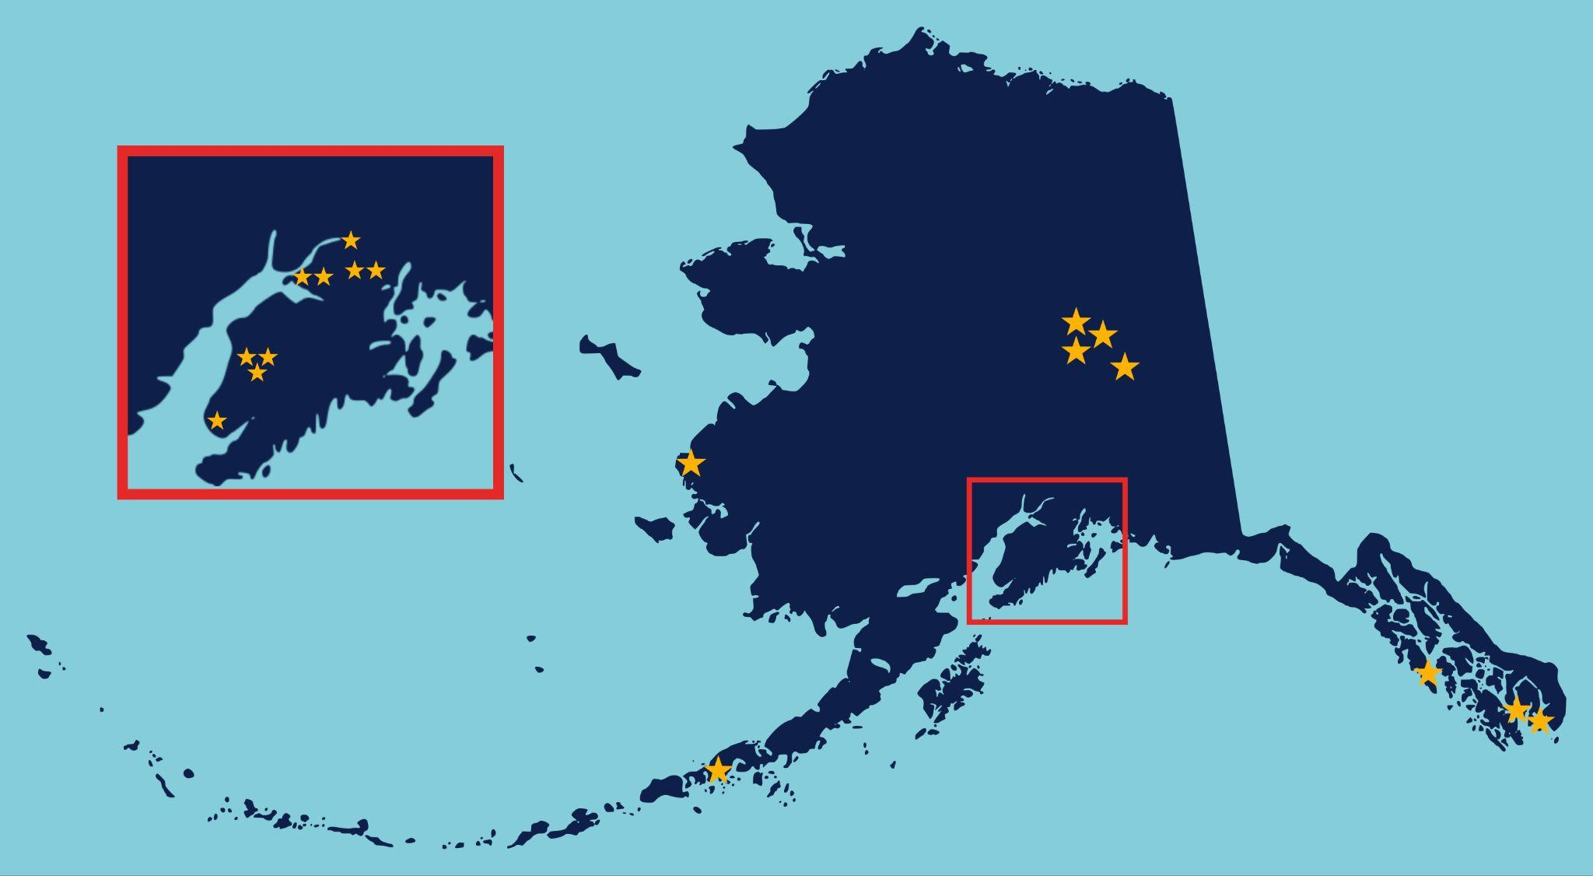
EWG Workgroup District Representation

Slide 16
Pause and Reflect
Notes:
Use this time to address any clarifying questions from the State Board.

Slide 17
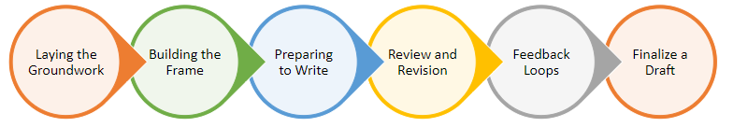
Process for Standards Development
Notes:
There are six main processes in the standards development. We will focus on the first four as they contribute to the finalization of the current draft Alaska Social Studies Standards.

Slide 18
Process for Standards Development
Each workgroup reviewed current research and trends in social studies education. They also analyzed and identified strengths and areas of improvement in the current Alaska standards.
Notes:
Link to lit review - https://docs.google.com/spreadsheets/d/1oQst9Q1dcHQ3OHett87PzoAjfHdkWc57/edit#gid=126808121

Slide 19
Process for Standards Development
Using their knowledge of current research/best practices, the national landscape of social studies, and various state standards, the GPWG and AHWG identified key “must haves” in the standards to develop guiding principles that served as a basis for the work.

Slide 20
Process for Standards Development
Sample Content Guiding Principles | Alaska Native culture, history, perspectives, values, and practices should be thoughtfully incorporated throughout the social studies standards and contextualized within a contemporary global indigeneity framework. Standards should provide opportunities for cross‐curricular connections, such as the relationships among science, technology, and society in global and historical contexts, which allow students to explore the development of diverse knowledge. Standards should include an economic strand that presents diverse economic systems, including state, federal, sovereign tribal, and unique economies in Alaska, and that analyzes the ecological impact of these systems.
Sample Structure Guiding Principles | Skills and content standards are arranged under common themes across grade bands. Standards incorporate and connect to the dimensions and indicators in the College, Career, and Civic Life Framework for Social Studies State Standards (C3 Framework) throughout K– 12. Standards are grounded in inquiry‐based practices and use fundamental or enduring questions that allow students to think critically, demonstrate learning through critical perspectives, and synthesize information in new ways.
Notes:
For each of the sample content and structure guiding principles, connect to the overarching strategic goals and mission/vision of the standards. Be sure to explain what is meant by “inquiry.”

Slide 21
Process for Standards Development
The EWG discussed the purpose of standards, what standards are, and criteria for high-quality standards and engaged in practice activities to write high-quality standards. They created the structure of the standards and reflected on anchor standards to guide their work.

Slide 22
Process for Standards Development
Criteria for High-Quality Standards | Definition
Rigor | A standard should help students understand knowledge and concepts that are complex, ambiguous, or contentious, and acquire skills that can be applied in a variety of educational, career, and civic contexts throughout their lives.
Focus | A standard should address what is most important for students to learn.
Specificity | A standard should be specific enough to convey the level of performance expected of students.
Clarity/Accessibility | Standards should be clear, measurable, observable, or verifiable in some way and in language that students and parents can understand.
Disciplinary Literacy | Standards as a whole should clearly articulate what is required of students to read, write and communicate within the specific discipline.
Coherence | Standards as a whole should be organized in a unified structure/framework devoid of gaps in learning expectations.
Depth | Standards as a whole should illustrate robust, well-integrated understandings of fundamental concepts essential to the attainment of literacy and fluency in a discipline.
Breadth | Standards as a whole should illustrate a logical and consistent structure that addresses the key content, concepts and skills of the discipline.

Slide 23
Process for Standards Development
The EWG worked in three grade-band groups (K–5, 6–8, 9–12) to revise the standards based on the guiding principles. Tasks were completed during in-person workshops, virtual meetings, and independent work.

Slide 24
Pause and Reflect
Notes:
Use this time to address any clarifying questions from the State Board.

Slide 25
Overview of the Standards and Key Instructional Shifts

Slide 26
Writing Team Leads
Melissa Masheff
Jessica Collins
Owen Fulton
Elementary Writing Team Lead
Middle School Writing Team Lead
High School Writing Team Lead

Slide 27
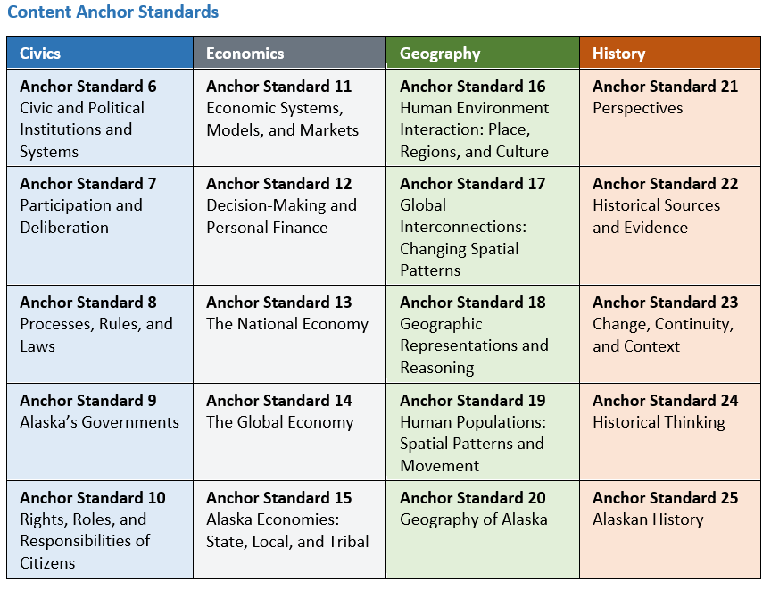
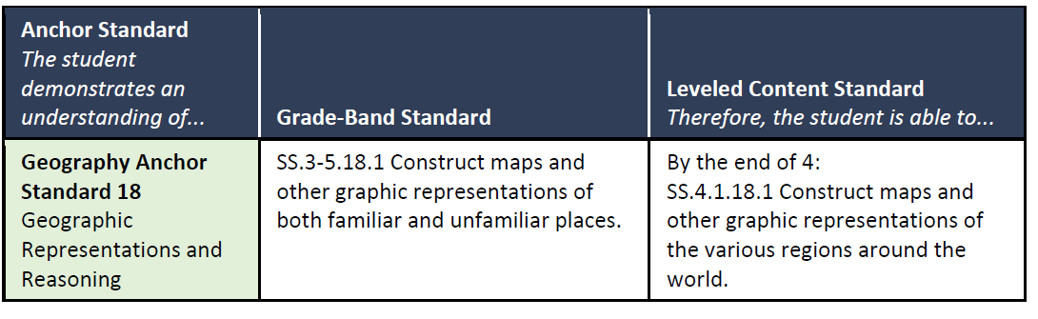
Overview of the Standards Structure
Notes:
Anchor Standards: Anchor standards provide lenses through which the essential skills and disciplinary knowledge of inquiry and action are practiced and applied. Anchor standards remain the same through all grades and courses and align closely with the dimensions of the C3 Framework.
Process for Developing Anchor Standards: Draft versions of the anchor standards were derived from example anchor standards in other states, along with ones based on or correlated to the C3 Framework and Alaska-specific components. The EWG collaborated on reviewing the draft anchor standards, reducing the number and adjusting the language to fit Alaska’s context and needs. Adjustments were also made to the anchor standards as appropriate as the writing teams worked through creating their standards.
Content Standards: Content standards define what students should know or be able to do in a specific grade or course. They emphasize the way each discipline provides foundational knowledge and skills essential to inquiry and action. Content standards are grade specific in grades K–5 and course specific in grades 6–12.

Slide 28
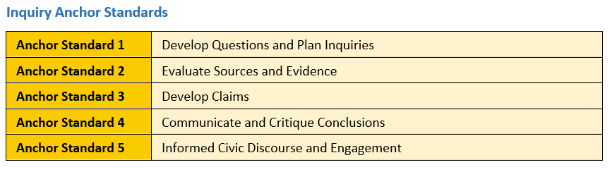
Overview of the Standards Structure
Notes:
Inquiry Standards: The inquiry standards define key skills within social studies by grade bands (i.e., K–2, 3–5, 6–8, and 9–12). These standards are meant to be used in concert with the content standards throughout the course of study, whenever appropriate. Working both individually and collaboratively, students engage in inquiry about important issues in social studies classes. Students utilize the inquiry process to analyze foundational knowledge, develop questions, apply tools to engage in research, weigh evidence, develop and communicate conclusions, and take informed action. How these standards will be integrated into the curriculum is a collaborative decision made by the state, districts, and schools.

Slide 29
Key Instructional Shifts
1. Thematic Social Studies Content and Skills | 2. Incorporate and Honor Alaska History and Tribal Government | 3. Understand Social Studies through Inquiry | 4. Develop Civic Knowledge, Skills, and Dispositions
Students build deep social studies content knowledge and skills by connecting learning thematically across disciplines. | Students engage with content that reflects their state’s diverse communities, cultures, perspectives, and voices across the social studies disciplines. | Students engage in productive struggle by investigating and asking questions grounded in social studies content and skills. | Students consistently develop and engage with civic knowledge, skills, and dispositions to become active and informed citizens.

Slide 30
Thematic Social Studies Content and Skills
Key Message
Organizing topics and concepts under themes helps move beyond rote memorization of facts to a recognition of patterns and understanding of connected ideas.
Major Shift
From encountering siloed information to ensuring the transfer of knowledge and understanding across interrelated topics and concepts.

Slide 31
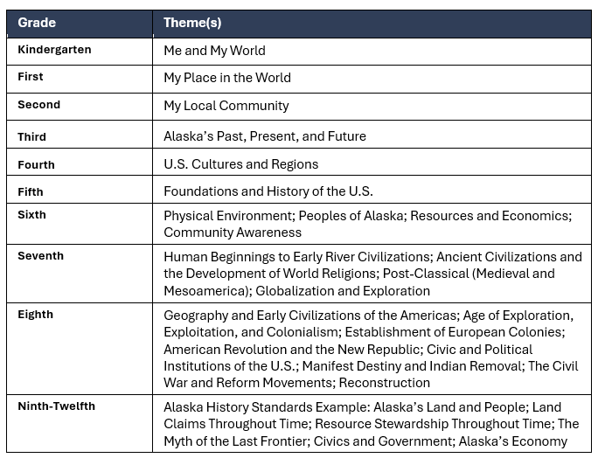
Organization of K-12 Standards by Themes
Notes:
Emphasize that the 9-12 Alaska History standards are also guided by time periods and timeframes.

Slide 32
Incorporate and Honor Alaska History and Tribal Government
Key Message
Emphasizing the Alaska context ensures an excellent education and equitable representation for every student.
Major Shift
From limited content on Alaska History, Tribal Government, and Indigenous histories to intentionally recognizing and honoring Alaska’s diverse communities, histories, and unique systems of government throughout K-12.

Slide 33
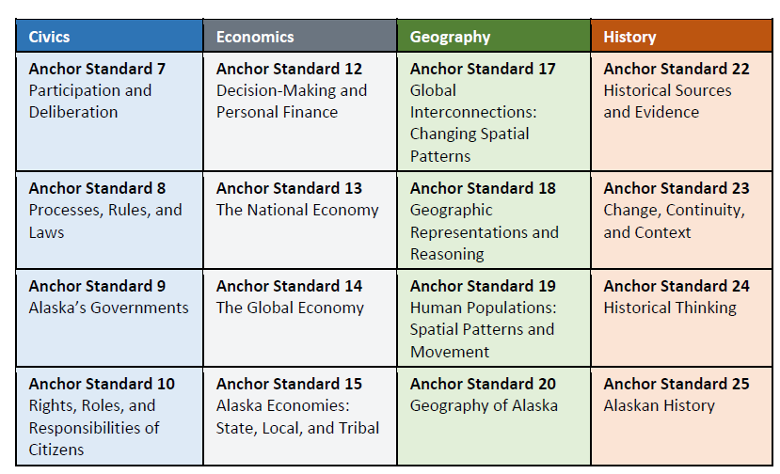
Example Alaska History-Specific Standards

Slide 34
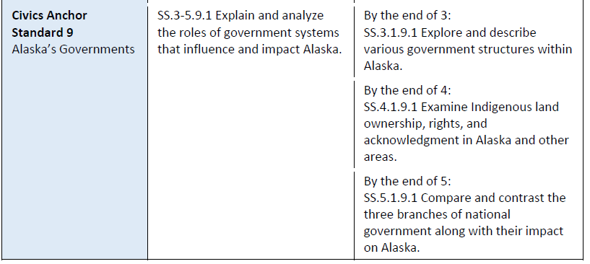
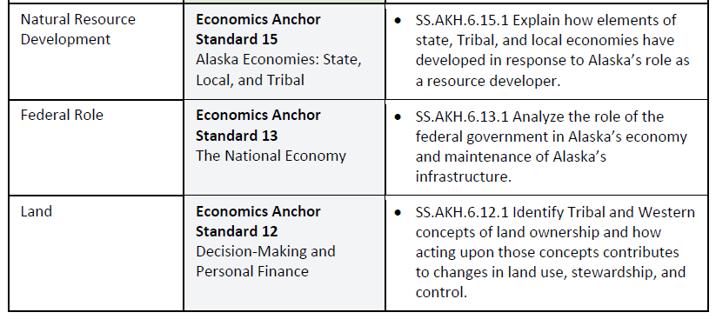
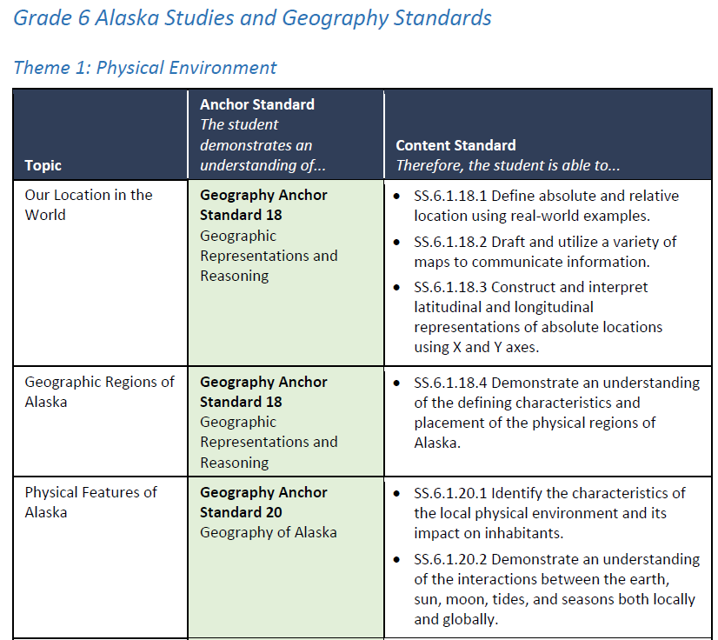
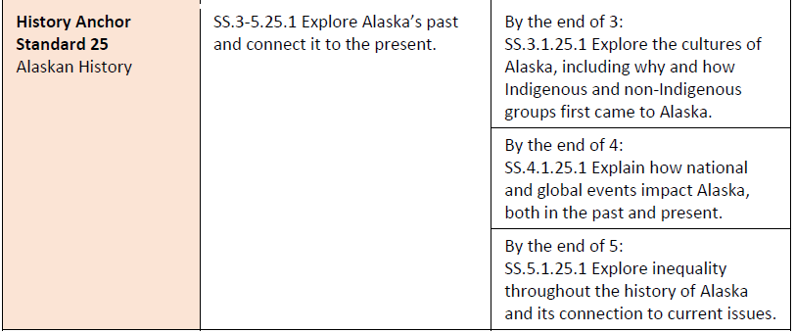
Example Alaska History-Specific Standards

Slide 35
Understand Social Studies through Inquiry
Key Message
Inquiry is teacher- and/or student-led and focused on compelling social studies content questions.
Major Shift
From learning about social studies to engaging in social studies

Slide 36
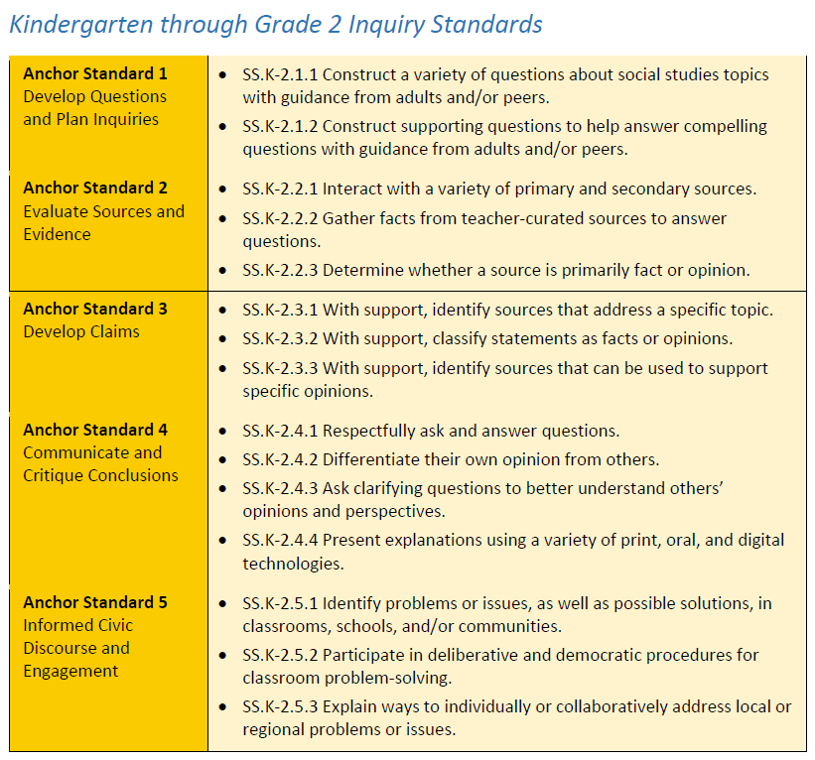
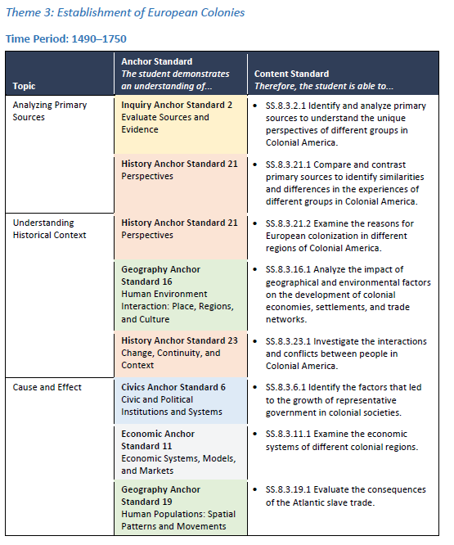
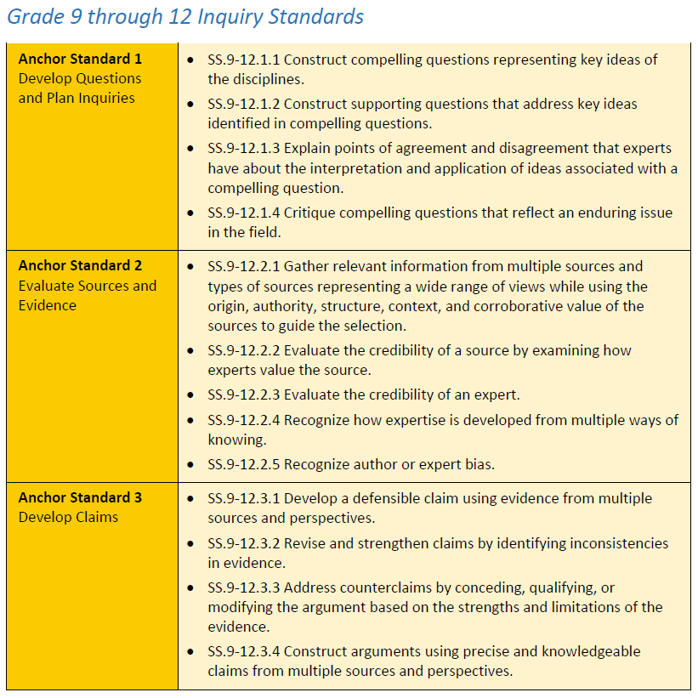
Example Inquiry Standards
Notes:
Emphasize that K-5 and 9-12 have separate inquiry standards. Grades 6-8 also have separate inquiry standards, but intentionally incorporate the inquiry anchor standards into their themes where appropriate.

Slide 37
Develop Civic Knowledge, Skills, and Dispositions
Key Message
Civic education throughout K-12 is imperative for preparing students to engage in a more diverse, complex society.
Major Shift
From separate government and citizenship standards to integrated civics knowledge, skills, and dispositions throughout K-12.

Slide 38
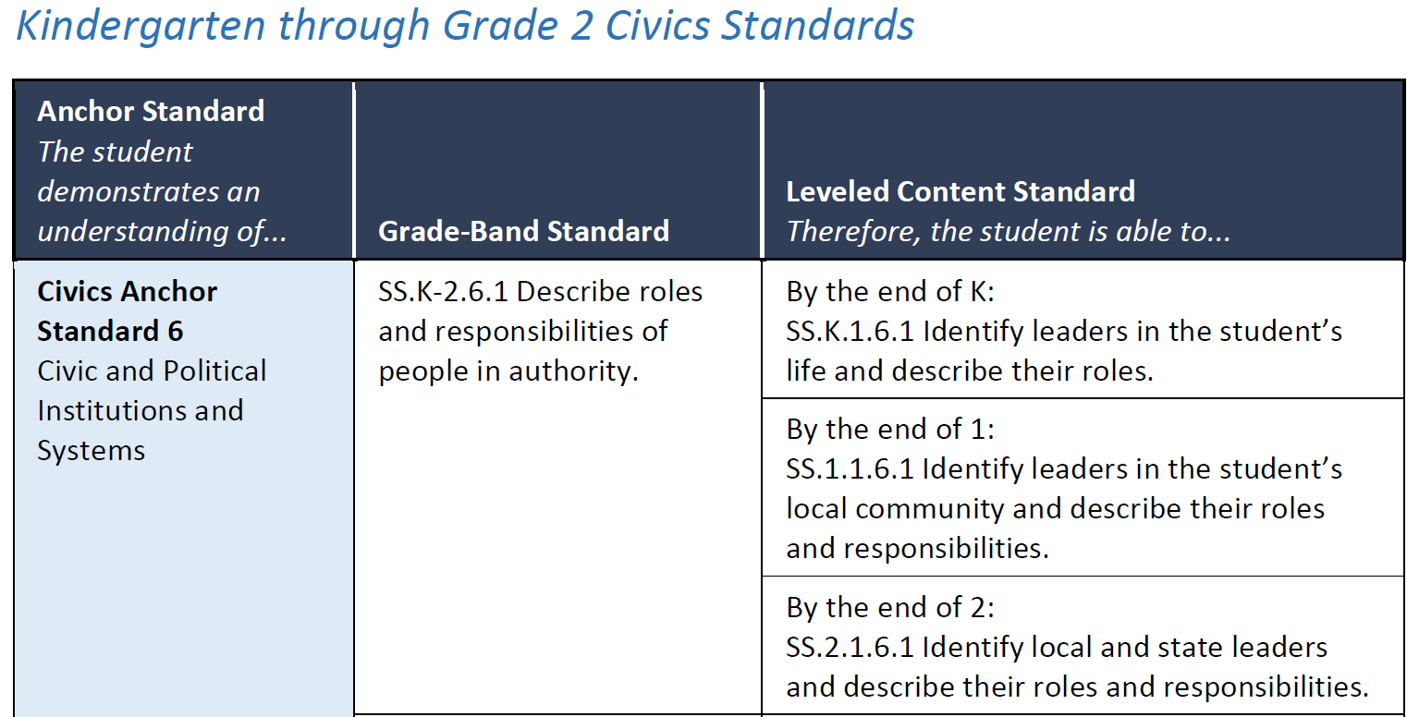
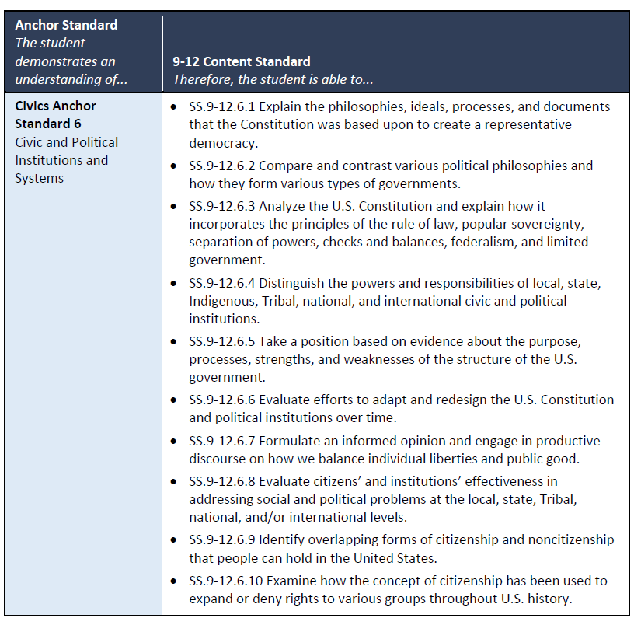
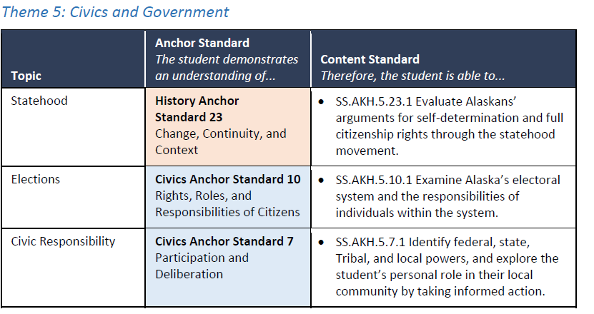
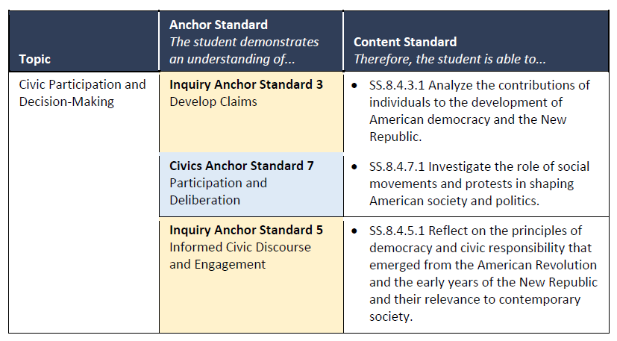
K-12 Civics Content Standards
Notes:
Emphasize use of the C3 FW in K-5. Highlight that for 9-12 there are stand alone civic standards and integrated civics standards by theme.

Slide 39
Q&A

Slide 40
Contact Information
Kelly Manning, Deputy Director for Alaska Department of Education and Early Development
kelly.manning@alaska.gov
(907) 465-8431
Kimberly Imel, Project Director, American Institutes for Research
kimel@air.org

